Slide 1

Introduction to raspberry pi.
prepared for Lowell Makes By, @leftyfb

Slide 2
Contents
Raspberry Pi
Linux
Boot up
Basic Linux
using the GPIO
Wiring Pi

Slide 3
Raspberry Pi
From Wikipedia:
“The Raspberry Pi is a series of credit card-sized single-board computers developed in the UK by the Raspberry Pi Foundation with the intention of promoting the teaching of basic computer science in schools”
The Model-B went on sale on the 29th February 2012 (The Model-A in February 2013). There are currently millions of Raspberry Pi owners worldwide. The bulk of Raspberry Pi computers are produced in Pencoed, South Wales

Slide 4
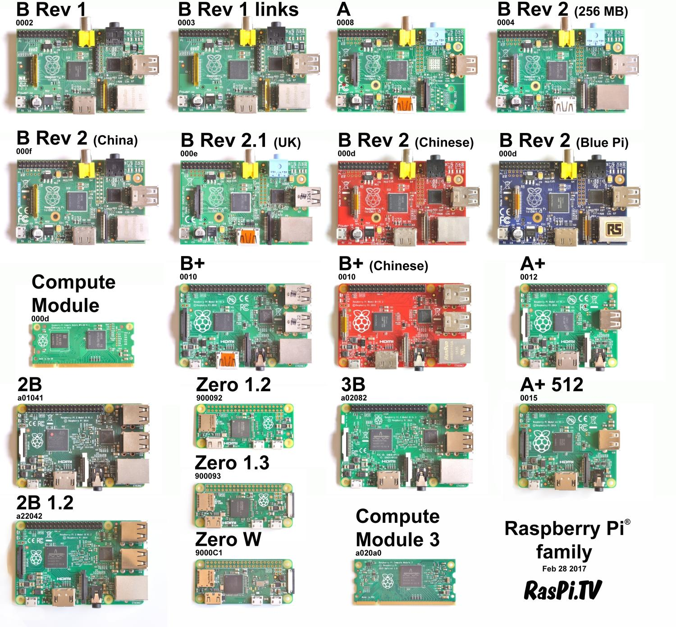
Raspberry Pi
The Model A has 256MB RAM, one USB port and no Ethernet (network connection). The Model B has 512MB RAM, 2 USB ports and an Ethernet port. The Model B+ shares the same specs as the Model B, but comes with 4 USB ports.

Slide 5
Raspberry Pi
The Model A+ is the low-cost variant of the Raspberry Pi. It has 256MB RAM, one USB port, 40 GPIO pins and no Ethernet port.
The Model B+ is the final revision of the original Raspberry Pi. It has 512MB RAM (twice as much as the A+), four USB ports, 40 GPIO pins, and an Ethernet port.
The Model 2 Model B, shares many specs with the Pi 1 B+, but it uses a 900MHz quad-core ARM Cortex-A7 CPU and has 1GB RAM. The Pi 2 is completely compatible with first generation boards, and is the model we recommend for use in schools, due to its flexibility for the learner.
The Pi 3 Model B was launched in February 2016; it uses a 1.2GHz 64-bit quad-core ARM Cortex-A53 CPU, has 1GB RAM, integrated 802.11n wireless LAN, and Bluetooth 4.1.
Finally, the Pi Zero is half the size of a Model A+, with a 1Ghz single-core CPU and 512MB RAM, and mini-HDMI and USB On-The-Go ports.
More differences on https://en.wikipedia.org/wiki/Raspberry_Pi#Specifications

Slide 6
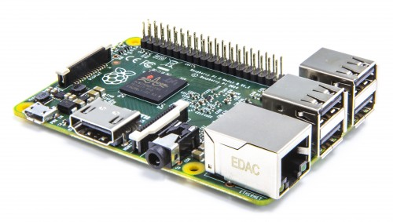
Raspberry Pi 3
1.2 GHZ quad-core ARM Cortex A53 (ARMv8 Instruction Set)
1 GB LPDDR2-900 SDRAM
USB ports: 4
Network: 10/100 MBPS Ethernet, 802.11n Wireless LAN, Bluetooth 4.0
Because it has an ARMv8 processor, it can run the full range of ARM GNU/Linux distributions, including Snappy Ubuntu Core, as well as Microsoft Windows 10.

Slide 7
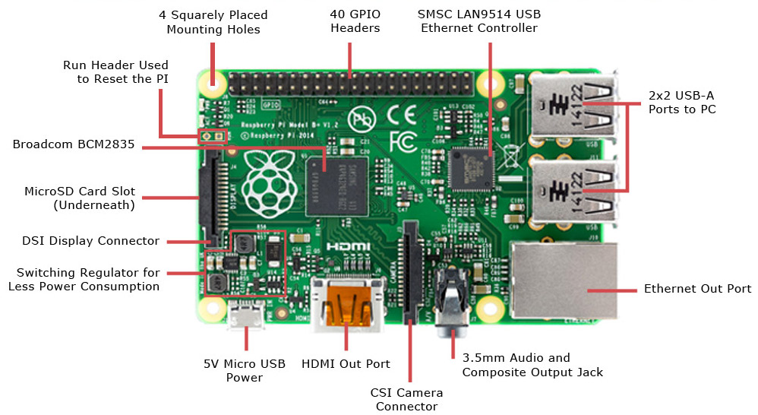
Raspberry Pi 3

Slide 8
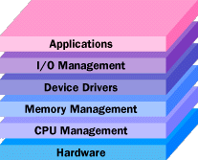
Linux
what is an Operating System(OS)?
It manages the hardware and software resources of the system. In a desktop computer, these resources include such things as the processor, memory, disk space and more (On a cell phone, they include the keypad, the screen, the address book, the phone dialer, the battery and the network connection).
It provides a stable, consistent way for applications to deal with the hardware without having to know all the details of the hardware.

Slide 9

Linux
Why linux?
GNU/Linux is a Free Operating system
GNU Project started in 1984 to create "free" Operating System
Linux Kernel (base of the system) created by Linus Torvalds in 1991
What can you do?
Freedom to use
Freedom to examine
Freedom to redistribute
Freedom to modify
What can't you do?
Deny these freedoms to anyone else

Slide 10
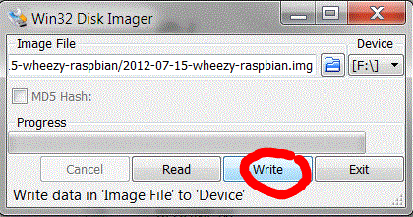
Boot your Pi
Linux/Mac:
sudo dd bs=1m if=path_of_your_image.img of=/dev/diskn
Windows:
download Win32 Disk Imager (http://sourceforge.net/projects/win32diskimager/)

Slide 11
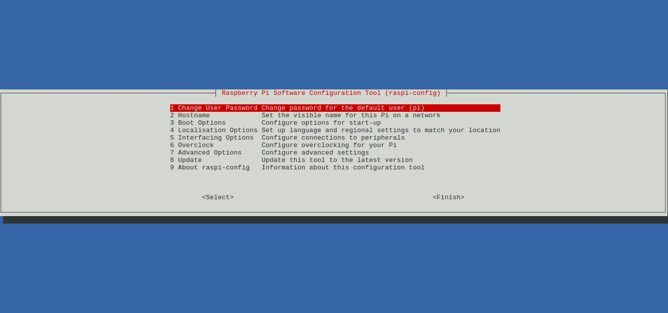
Boot your Pi
Expand Filesystem (PIXEL seems to do this automatically now)

Slide 12
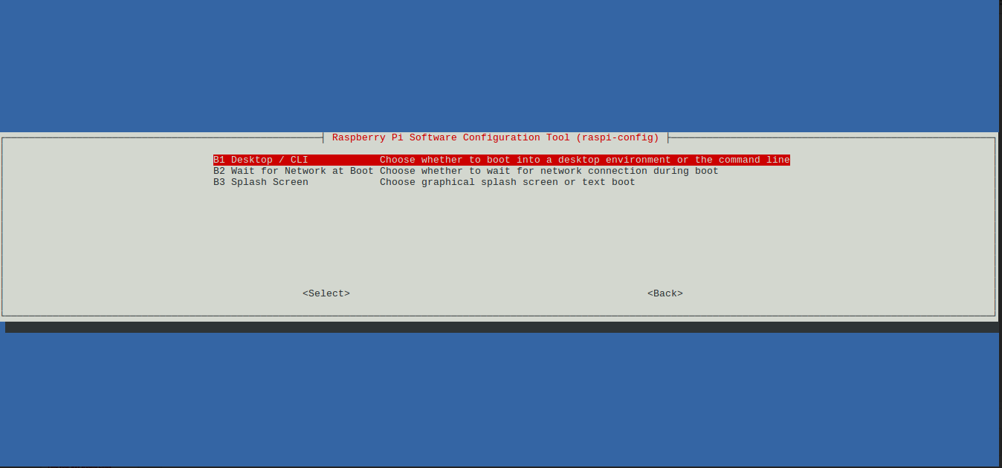
Boot your Pi
Boot options

Slide 13
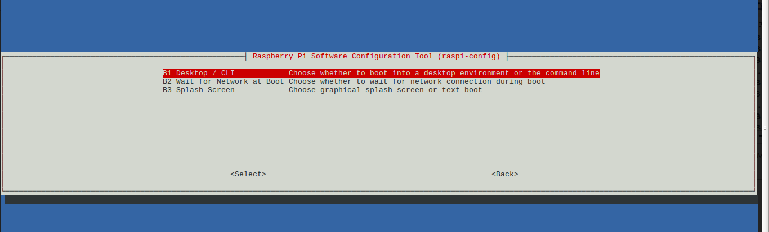
Boot your Pi
Expand Filesystem
Boot options

Slide 14
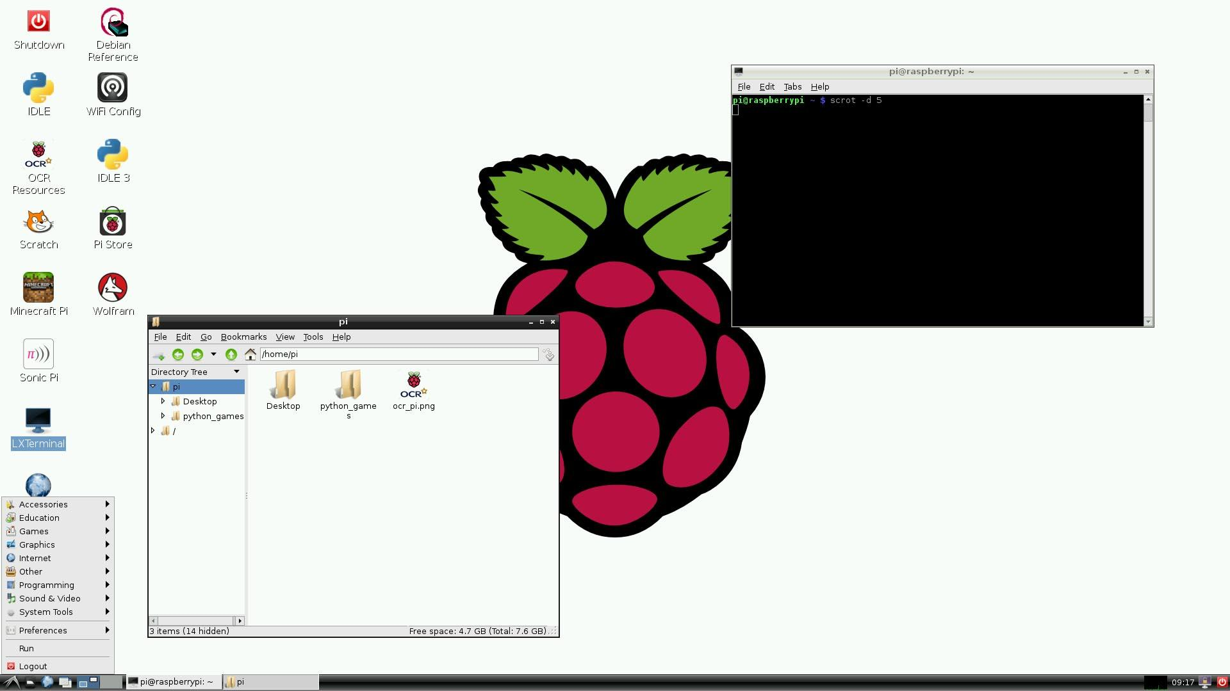
Boot your Pi
PIXEL Desktop Graphical OS

Slide 15
Find your way around Linux
cd
ls
.files
mkdir
echo
;
cat
tail
head
>
while true
variables
if statements

Slide 16
Pi GPIOs
These pins are a physical interface between the Pi and the outside world. At the simplest level, you can think of them as switches that you can turn on or off (input) or that the Pi can turn on or off (output). Of the 40 pins, 26 are GPIO pins and the others are power or ground pins (plus two ID EEPROM pins which you should not play with unless you know your stuff!)

Slide 17
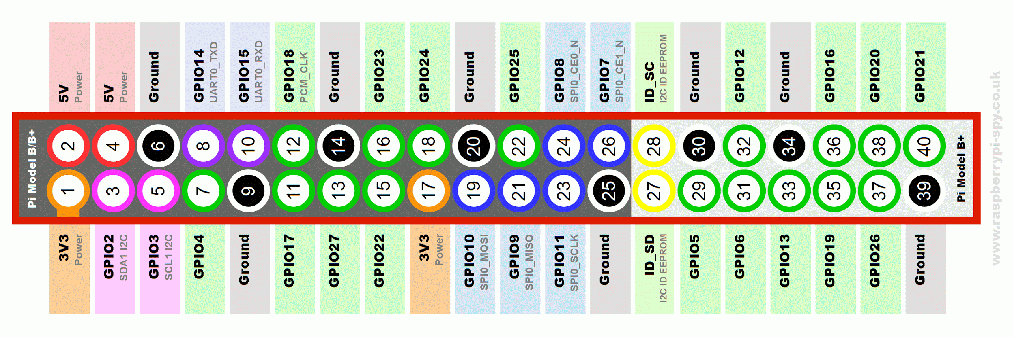
Pi GPIOs
GPIO (40)
SPI (3)
I²C (2)
UART (1)
PWM (1)

Slide 18
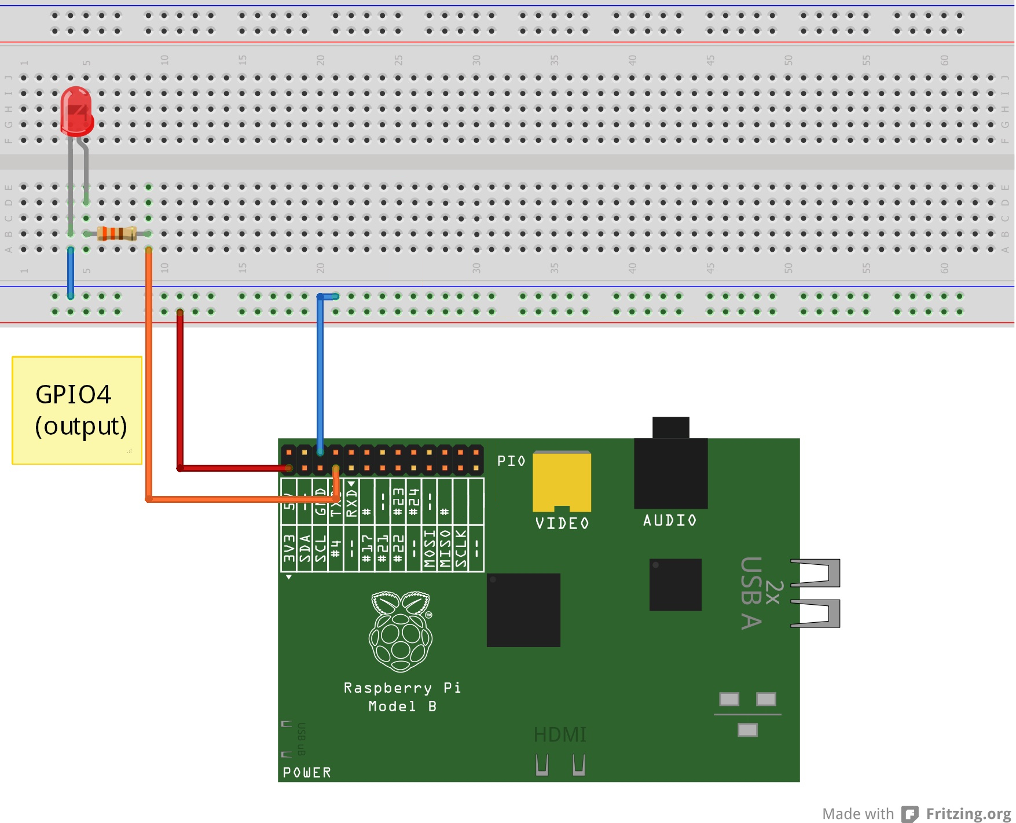
Pi GPIO
Blink LED

Slide 19
Pi GPIO
Blink LED
1a. Bonus
Try to blink 2 LED’s using
only 1 GPIO pin.

Slide 20
Pi GPIO
Blink LED
1a. Bonus
Try to blink 2 LED’s using
only 1 GPIO pin.
Hint: What happens to
the GPIO pin when the
LED is not lit?

Slide 21
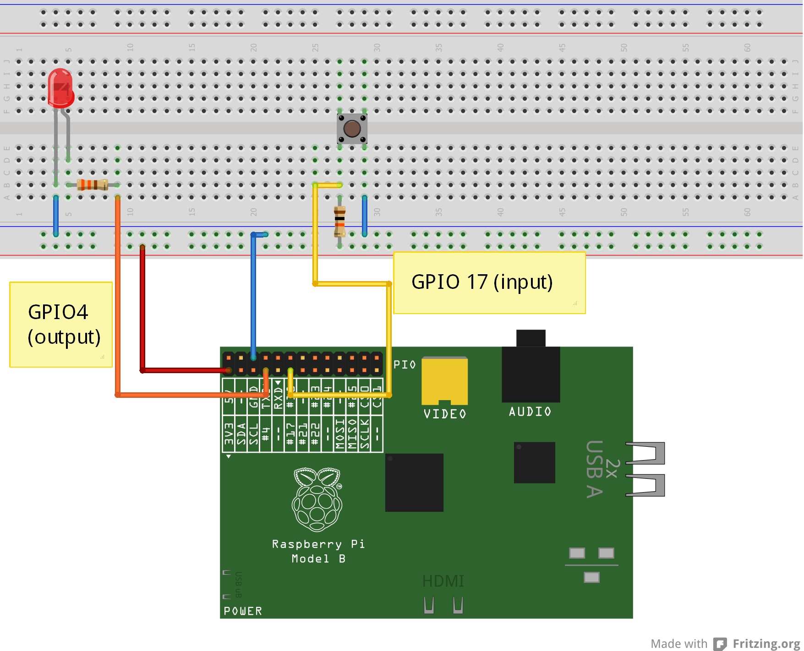
Pi GPIO
Blink LED
1a. Bonus
Try to blink 2 LED’s using
only 1 GPIO pin.
Hint: What happens to
the GPIO pin when the
LED is not lit?
Push Button

Slide 22
Questions?

